Slide 1
Omnimagnet Mind Map
Mohamed Ghori

Slide 2
Mind Map
MAIN
Master Function to run entire Omnimagnet Simulation.
SHAPE
Trajectory Shape Function that rolls the ball through a specific trajectory. Using CNTRL it returns a VISUAL & DATA
CNTRL
Trajectory Following Function that uses MATH to output DATA & Visual
MATH
Math Tools (ie. rotx.m : rotation about the x-axis )
VISUAL
Visualization of the tool’s simulated trajectory
DATA
Solenoid Current Values
MAIN
SHAPE
CNTRL
MATH
Data
VISUAL

Slide 3
MAIN
MAP
SHAPE
MAIN( type, x0, y0, phi, psi, ShapeSize, T, dt, speed, ballsize )
TYPE
INITIAL POSITION & ORIENTATION & SHAPEVALUE
PERIOD & TIME STEP
VIDEO SPEED & TOOL SIZE

Slide 4
TYPE
MAIN
TYPE
1: Square/Rectangular Shape
2: Circle

Slide 5
INITIAL POSITION & ORIENTATION & SHAPEVALUE
MAIN
SHAPE
INITIAL POSITION & ORIENTATION & SHAPEVALUE
Initial Position
X0 : initial x position
Y0: initial y position
Initial Orientation
Phi: longitudinal position of north pole
Psi: latitudinal position of north pole
Defining value of trajectory’s shape
Shapevalue: defining value for shape
(rectangle = [corner-x, conrer-y])
(Circle = radius)

Slide 6
PERIOD & TIME STEP
MAIN
SHAPE
PERIOD & TIME STEP
T : time to complete task
dt: time steps to record/observe

Slide 7
VIDEO SPEED & TOOL SIZE
MAIN
SHAPE
VIDEO SPEED & TOOL SIZE
Speed: multiplier that speeds up the visualization
Tool Size: defines the size(radius) of the magnetic tool

Slide 8
SHAPE
MAP
CNTRL
rollBallInSquare( x0, y0, phi, psi, ShapeSize, T, dt, speed, ballsize )
rollBallInCirlce( x0, y0, phi, psi, ShapeSize, T, dt, speed, ballsize )
INITIAL POSITION & ORIENTATION & SHAPEVALUE
PERIOD & TIME STEP
VIDEO SPEED & TOOL SIZE

Slide 9
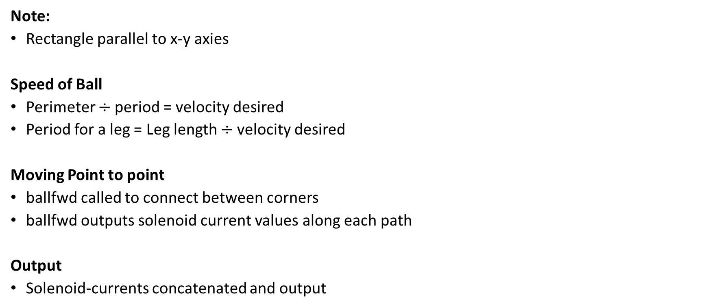
rollBallInSquare
SHAPE
Note:
Rectangle parallel to x-y axies
Speed of Ball
Perimeter $÷$period = velocity desired
Period for a leg = Leg length $÷$velocity desired
Moving Point to point
ballfwd called to connect between corners
ballfwd outputs solenoid current values along each path
Output
Solenoid-currents concatenated and output
Velocity
Magnet
N

Slide 10
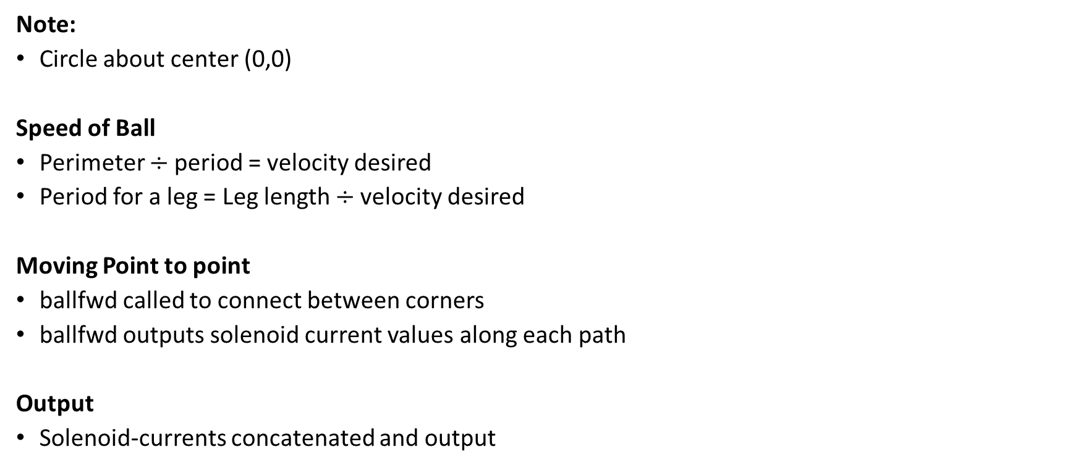
rollBallInCircle
SHAPE
Note:
Circle about center (0,0)
Speed of Ball
Perimeter $÷$period = velocity desired
Period for a leg = Leg length $÷$velocity desired
Moving Point to point
ballfwd called to connect between corners
ballfwd outputs solenoid current values along each path
Output
Solenoid-currents concatenated and output
Velocity
Magnet
N

Slide 11
CNTRL
MAP
MATH
Ballfwd (p0, pf, wRb, T, dt, speed, ballsize )
Fwdcurrent (I0, If, wRb, T, dt, speed, ballsize )
fwdMagneticField (currx, curry, currz, x, y )
inverseMagneticField (x, y, phi, psi)

Slide 12
ballfwd
CNTRL
Note:
Rolling about Magnetic Field y-Axis
Find Goal:
Rotate about world z-axis
T(ballfwd Period)/4
Return current for orientation snapshots at “0 : dt :T/4”
Roll to Goal:
Rotate about Magnetic Field y-Axis
3T/4
Return current for orientation snapshots at “T/4 : dt : T”

Slide 13
fwdcurrent
CNTRL
Note:
Rotates magnetic Field around single axis
Rotating Tool
Method:
Two consecutive orientations are found using two consecutive current vectors
The orientations are decomposed in terms of rotation in the xy-plane(phi) & the xz-plane(psi)
The difference in psi and phi are then converted to a rotation matrix
This rotation matrix is decomposed into an axis and angle rotation
The magnetic field is then rotated about this axis
The linear velocity consists of the rotation vector in the xy-plane
Output:
Final Position and Orientation (pf, wRb)

Slide 14
fwdMagneticField
CNTRL
Input:
Electric Current for each solenoid (currx,curry,currz)
Current Position of Ball (x,y)
EQN:
Current put in as a vector into equation from Jake Abbott
Output:
Magnetic Field Vector Tangent to Magnetic Field at the Tool

Slide 15
inverseMagneticField
CNTRL
Input:
Orientation of the magnetic field at the Tool (phi,psi)
Current Position of Ball (x,y)
EQN:
Magnetic Field vector constructed using orientation with a magnitude of 100
Magnetic Field vector put into equation from Jake Abbott
Output:
Electric Current for each solenoid [currx; curry; currz]

Slide 16
MATH
MAP
VISUAL
anglediff (vect1,vect2);
findPhiPsi (R)
Vect2skew (vector)
Rotx (roll)
Roty (pitch)
Rotz (yaw)
HomoMatrix (rpy, pos)

Slide 17
anglediff
MATH
Find the angle of the two vectors with respect to the world x-axis in the xy-plane
The difference between these two angles is the angle between vectors

Slide 18
findPhiPsi
MATH
Using “arccos” to find the angle from the world x-axis in the zx-plane (psi)
Using “arccos” to find the angle from the world x-axis in the xy-plane (phi)

Slide 19
vect2skew
MATH
Converts from a vector its skew symmetric matrix form

Slide 20
rotx roty rotz
MATH
Basic Euler rotation matrix equations (roll, pitch, yaw)

Slide 21
HomoMatrix
MATH
Creates a homogeneous matrix from a position and a vector of [roll pitch yaw]

Slide 22
VISUAL
MAP
DATA
plot_ball(ballsize,pos,R,dt,speed)
Showmagfield(currx,curry,currz,p0)

Slide 23
plot_ball
VISUAL
First Call creates a figure of equal axis at a corner view
Draws a transparent sphere
Draws a quiver along the z-axis and y-axis of the magnetic field

Slide 24
showmagfield
Draws a magnetic field line using a series of 200 segments (quivers) from head to tail

Slide 25
DATA
MAP
Solenoid-current(curra, currb, currc)

